Slide 1
Correlation between Wine Ratings and Location
Considerations:
Number of data points after cleaning dataset: 129,909
‘nan’ values changed to ‘Unlisted’
Questions asked:
How does wine rating differ by country?
Which provinces produce most wine (top 30)?
What is the average rating for most wines?
There are provinces with higher number of vineyards/wineries? Does this translate to higher wine ratings for a country?
Does a higher wine rating imply most coveted wine?

Slide 2
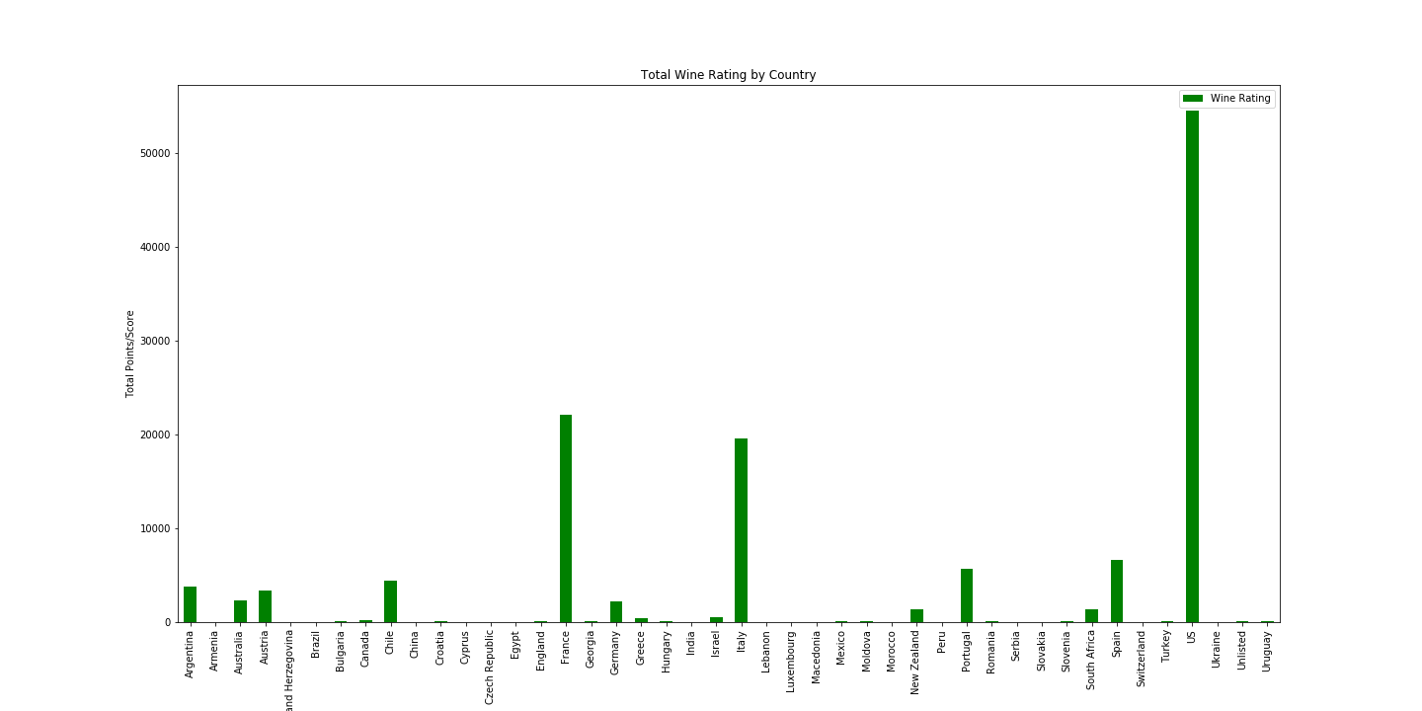
Total Wine Ratings by Country
Top 5 Ratings:
USA: 54,504 (42%)
France: 22,093 (17%)
Italy: 19,540 (15%)
Spain: 6,645 (5%)
Portugal: 5,691 (4.4%)

Slide 3
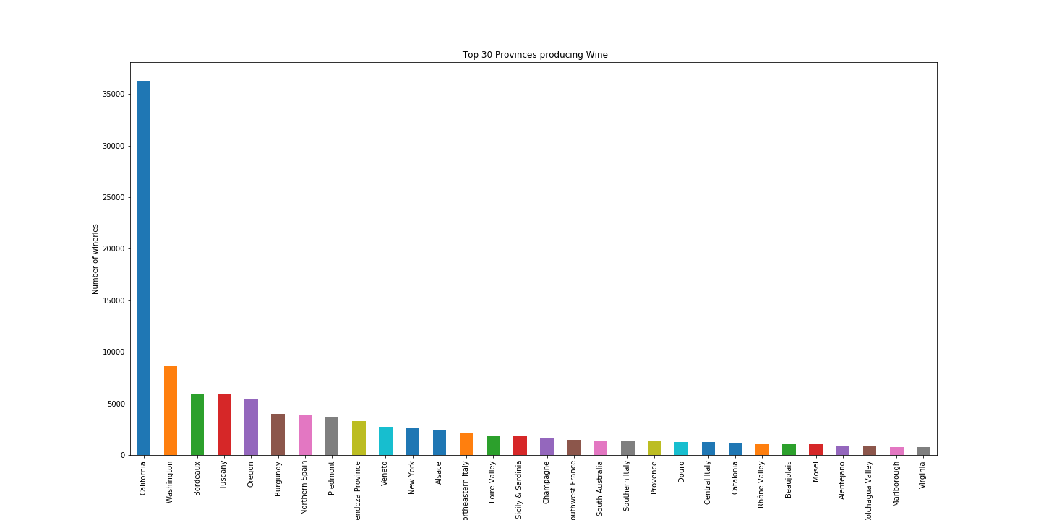
Top 30 Wine producing Provinces
Datapoints Count: 129,909
California: 36,248 (28%)
Washington: 8,640 (6.7%)
Bordeaux: 5,942 (4.6%)
Tuscany: 5,898 (4.5%)
Oregon: 5,374 (4.1%)
Burgundy: 3,981 (3.1%)
Northern Spain: 3,852 (3%)
Texas: 95 (0.07%)

Slide 4
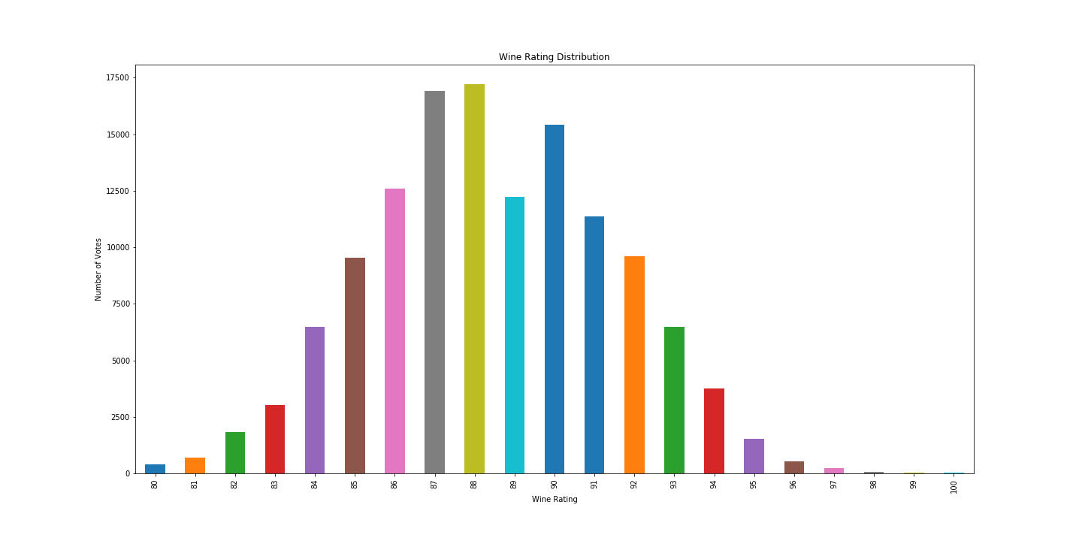
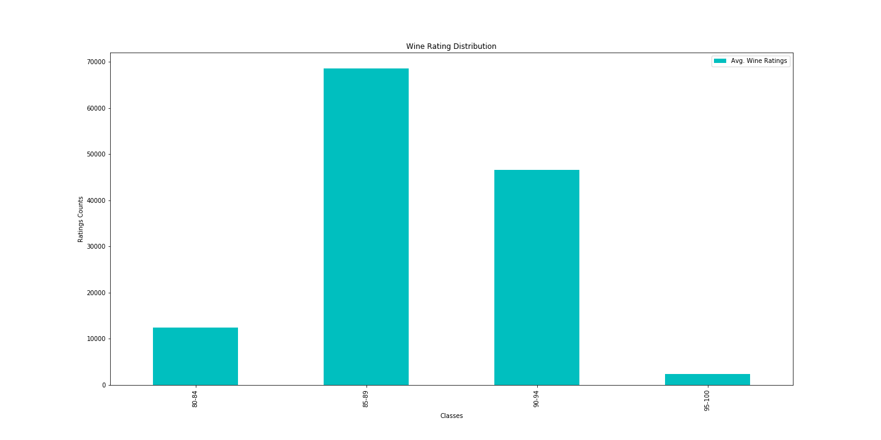
Wine Rating Distribution
Total Ratings Count:129,909
Avg. Wine Rating

Slide 5
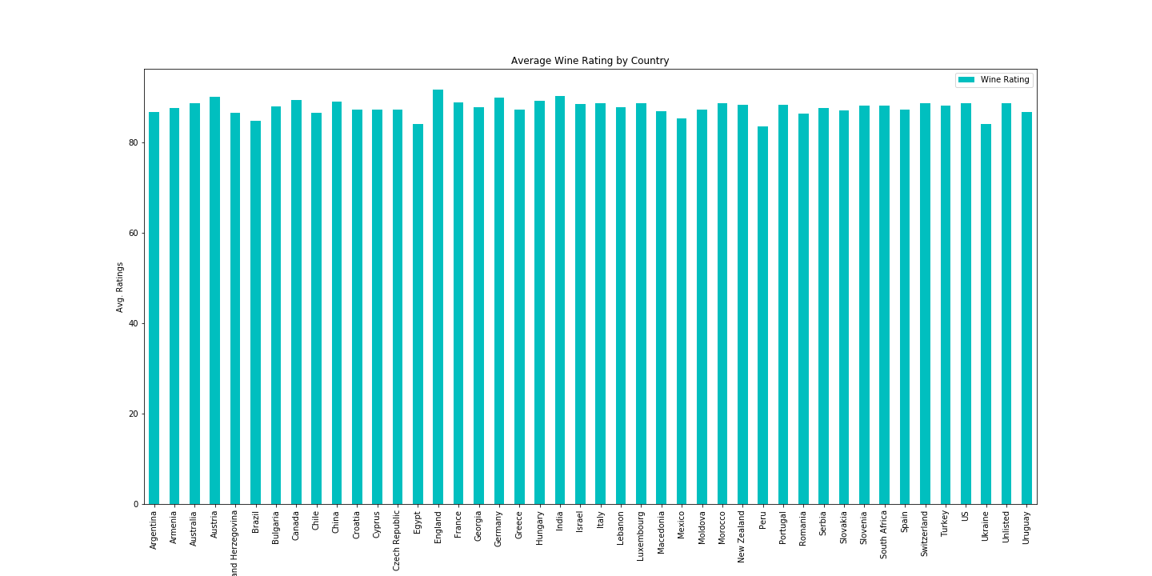
Average Wine Ratings by Country

Slide 6
Avg. Wine Ratings for top 12 Countries
S.No. | Country | Total Ratings | Avg. Rating
1 | England | 75 | 91.6
2 | Austria | 3,345 | 90.1
3 | Germany | 2,165 | 89.9
4 | Canada | 257 | 89.4
5 | France | 22,093 | 88.8
6 | USA | 54,504 | 88.6
7 | Italy | 19,540 | 88.6
8 | Australia | 2,329 | 88.6
9 | Portugal | 5,691 | 88.3
10 | Spain | 6,645 | 87.2
11 | Argentina | 3,800 | 86.7
12 | Chile | 4,472 | 86.5

